Slide 1

3 Day Startup
Sunday Presentations
Notes:
#amazing

Slide 2
Education is broken

Slide 3






Slide 4
Massive Open Online Courses
Open Source Education
Standard teaching

Slide 5
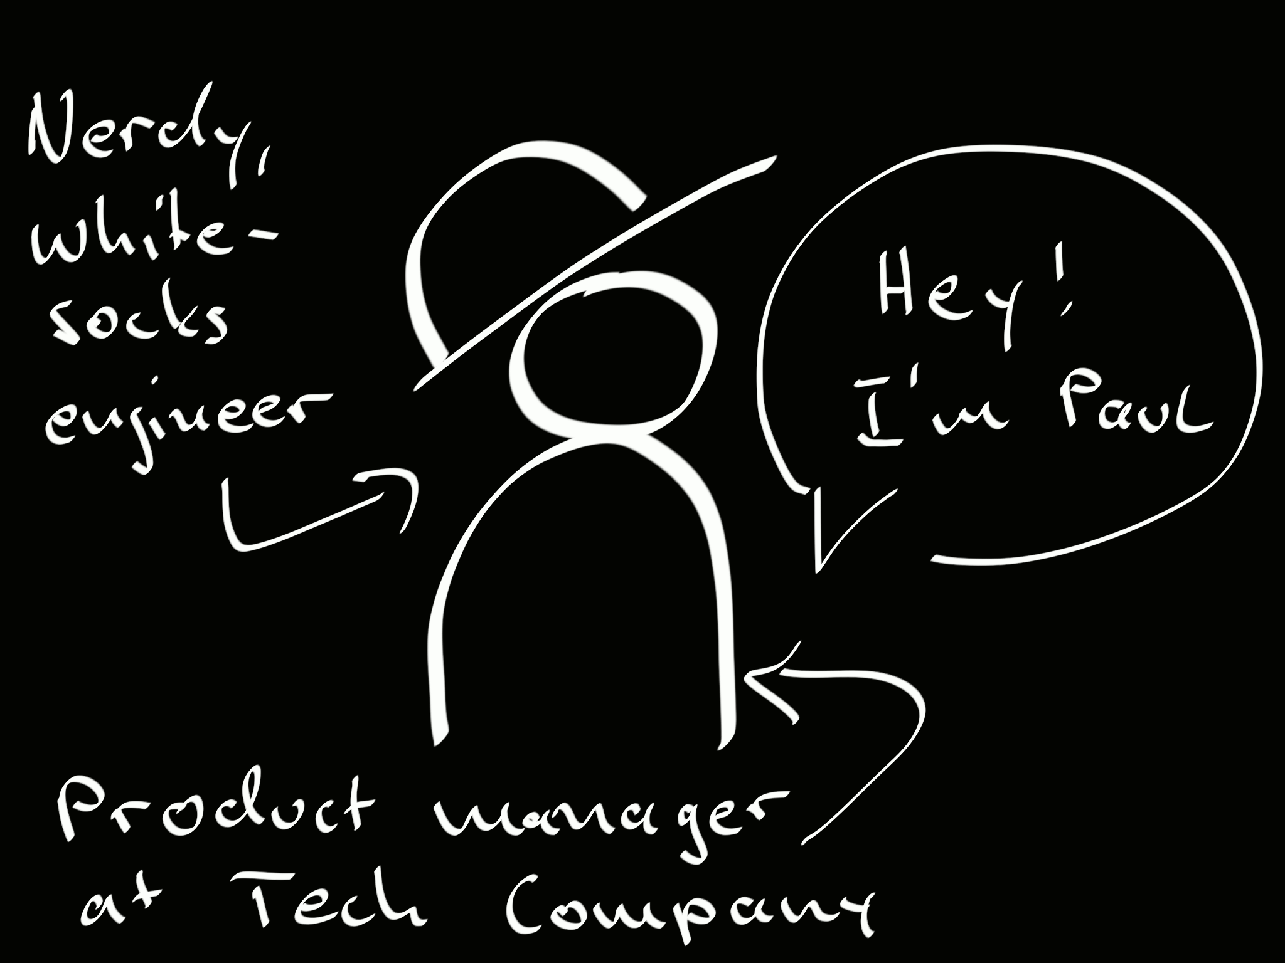

Slide 6
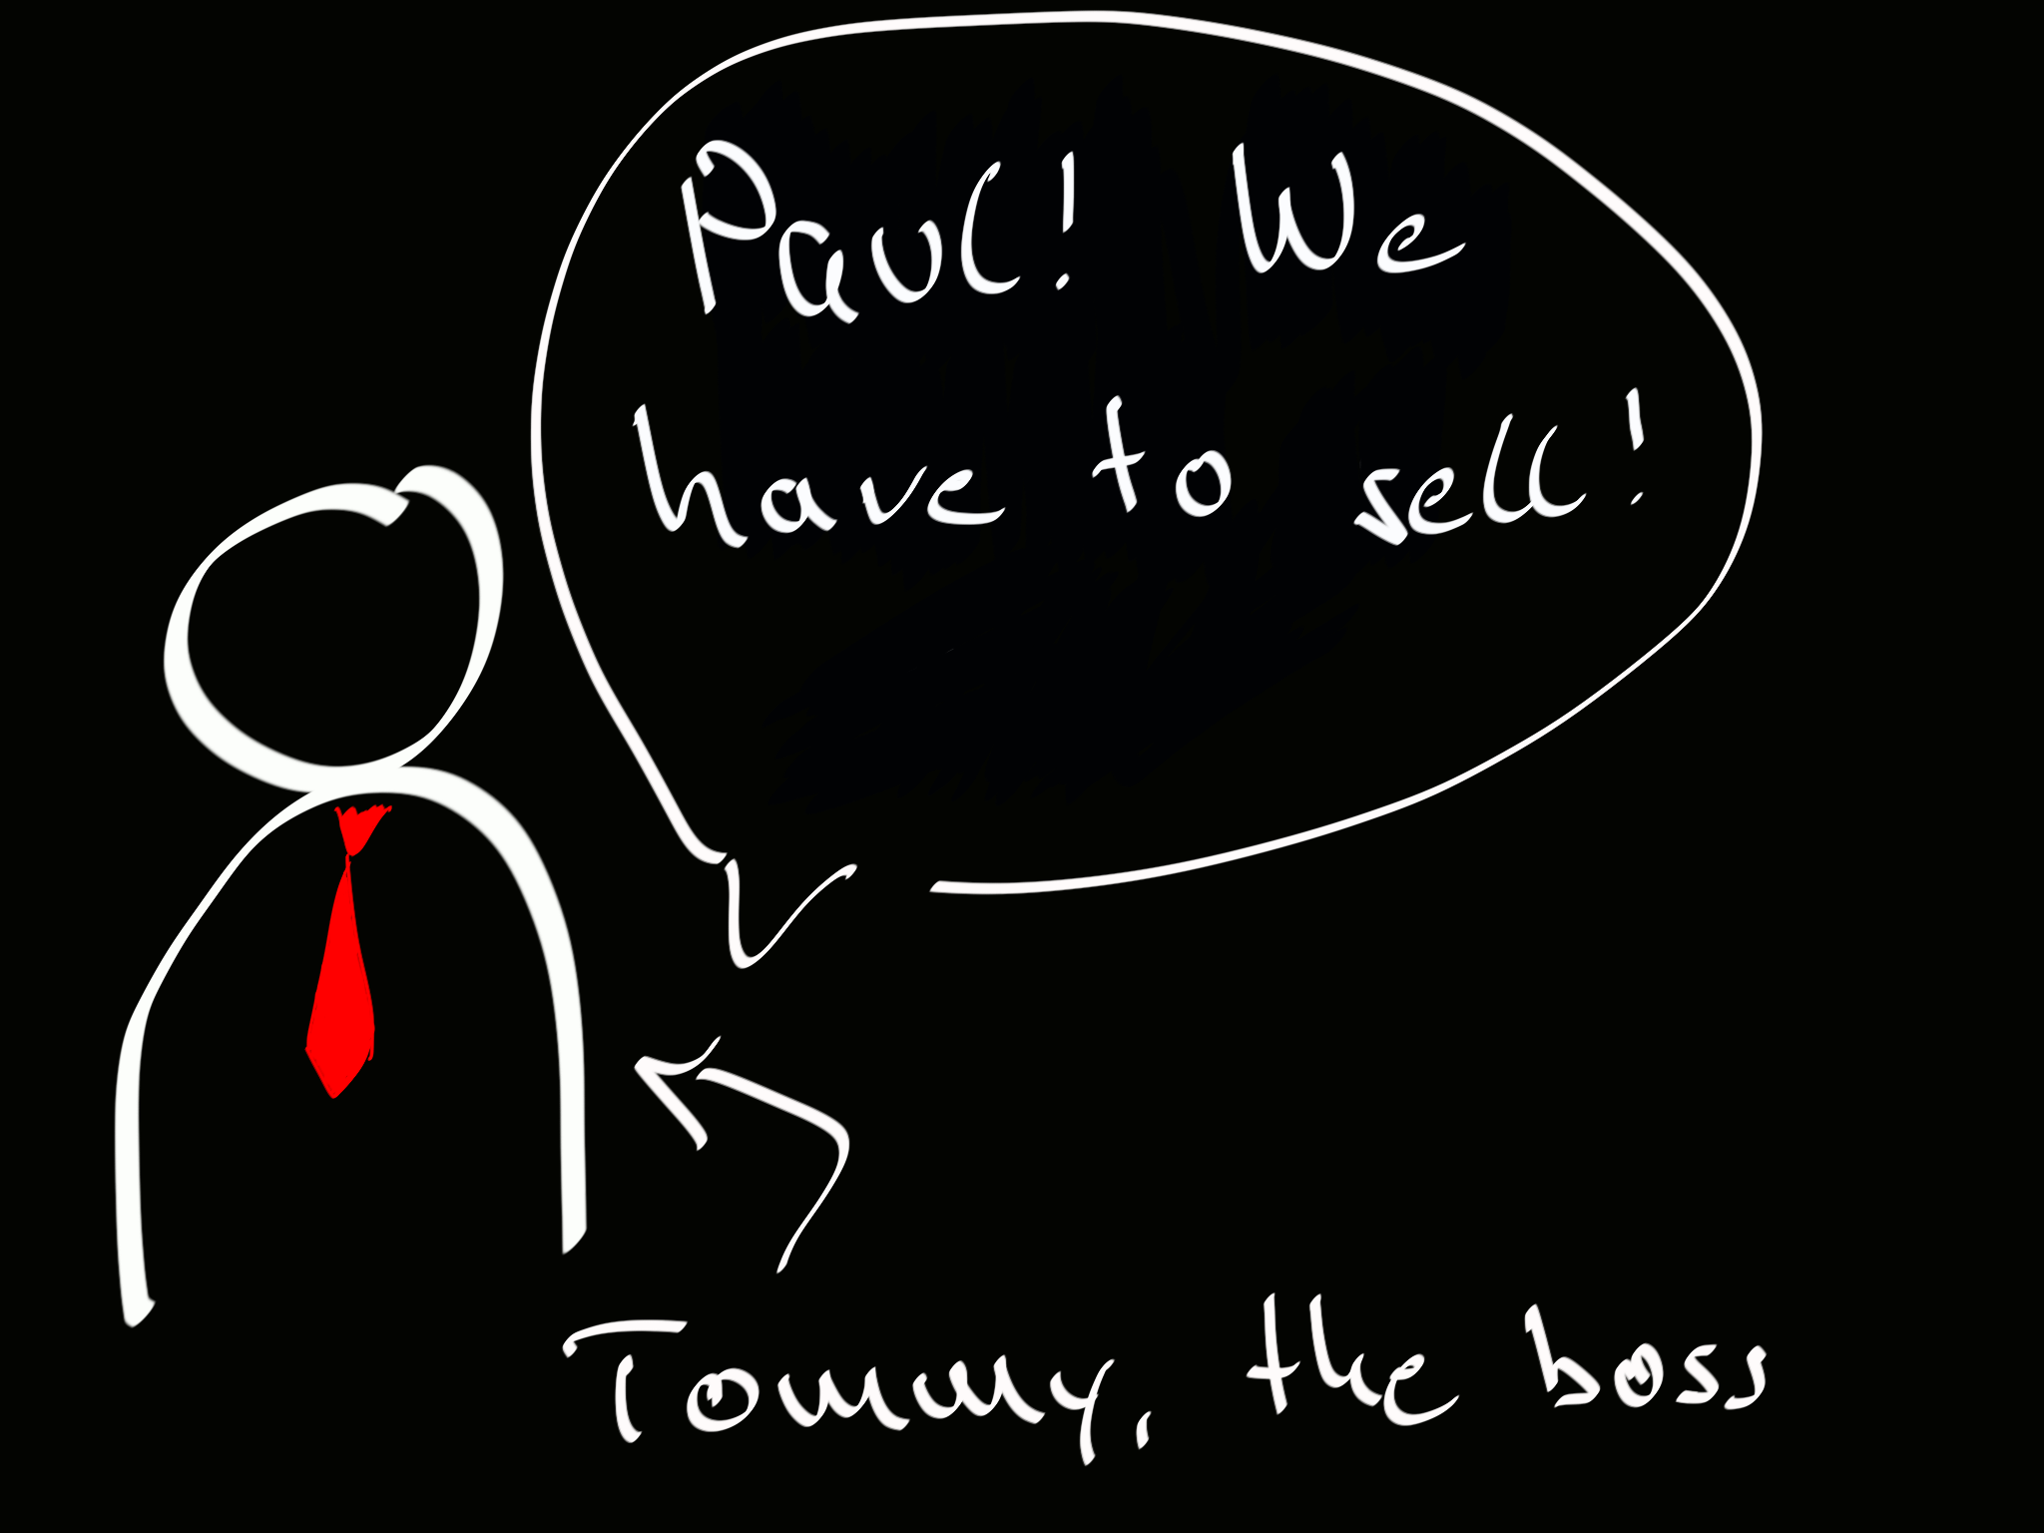

Slide 7


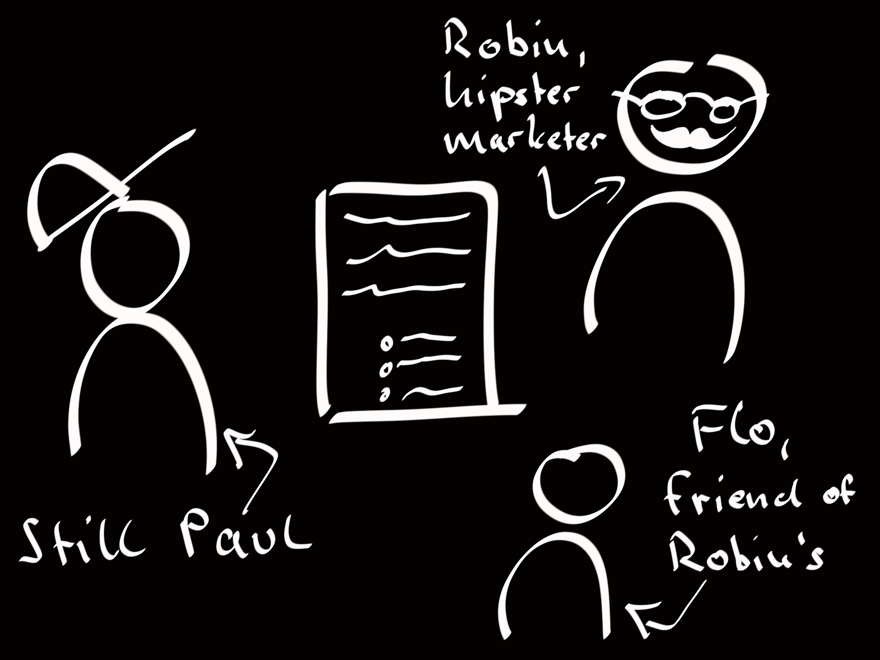

Slide 9
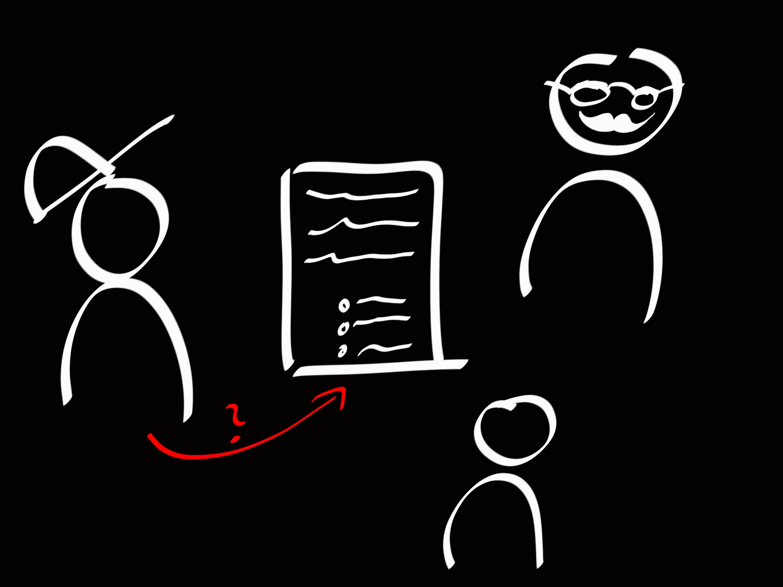

Slide 10
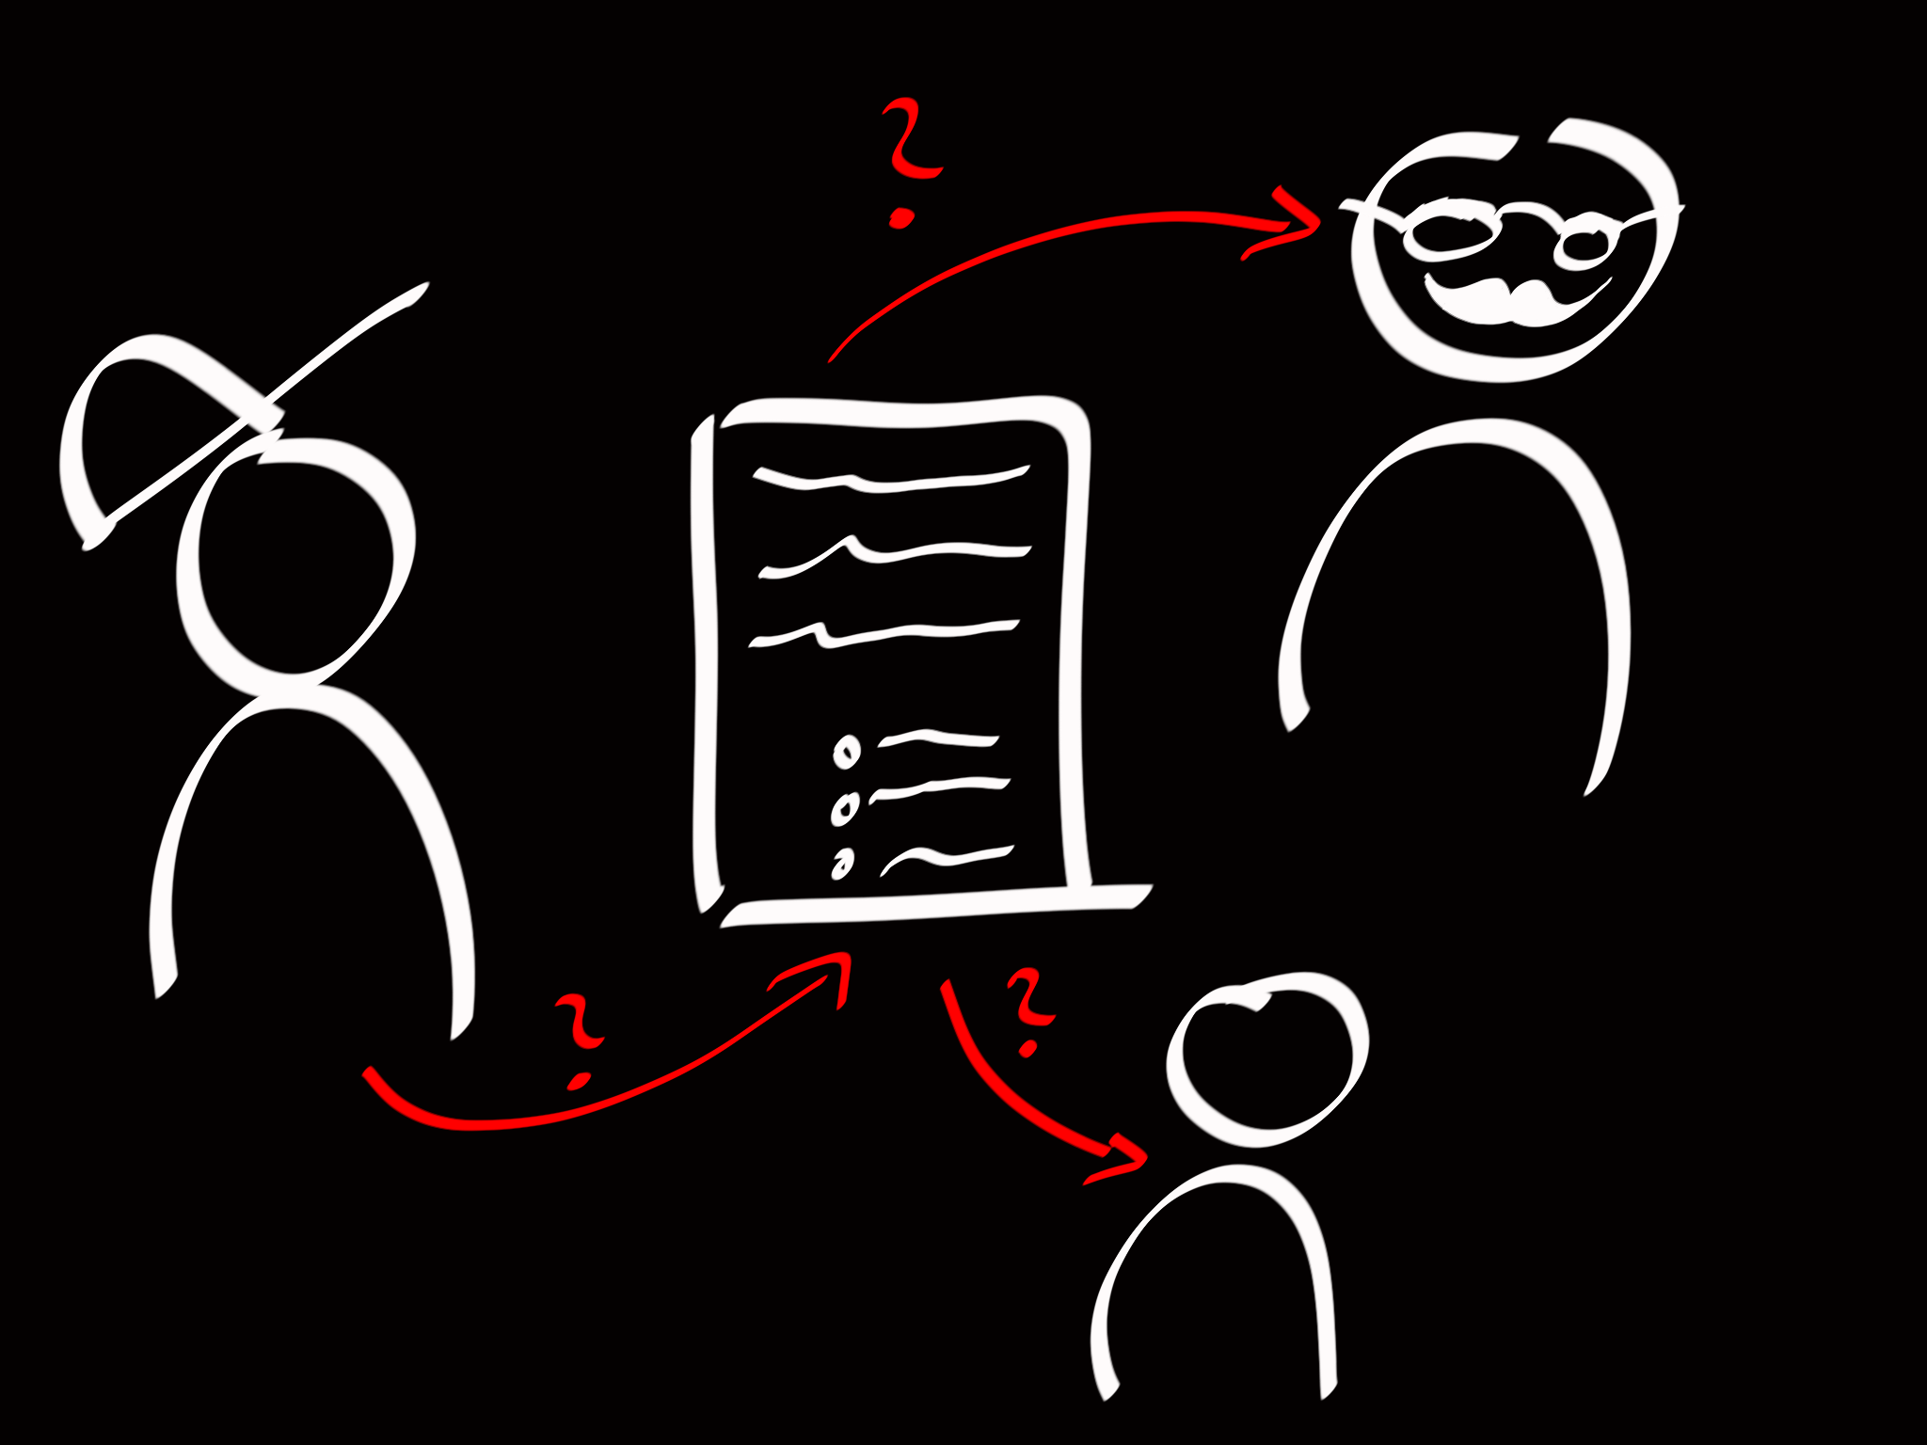

Slide 11
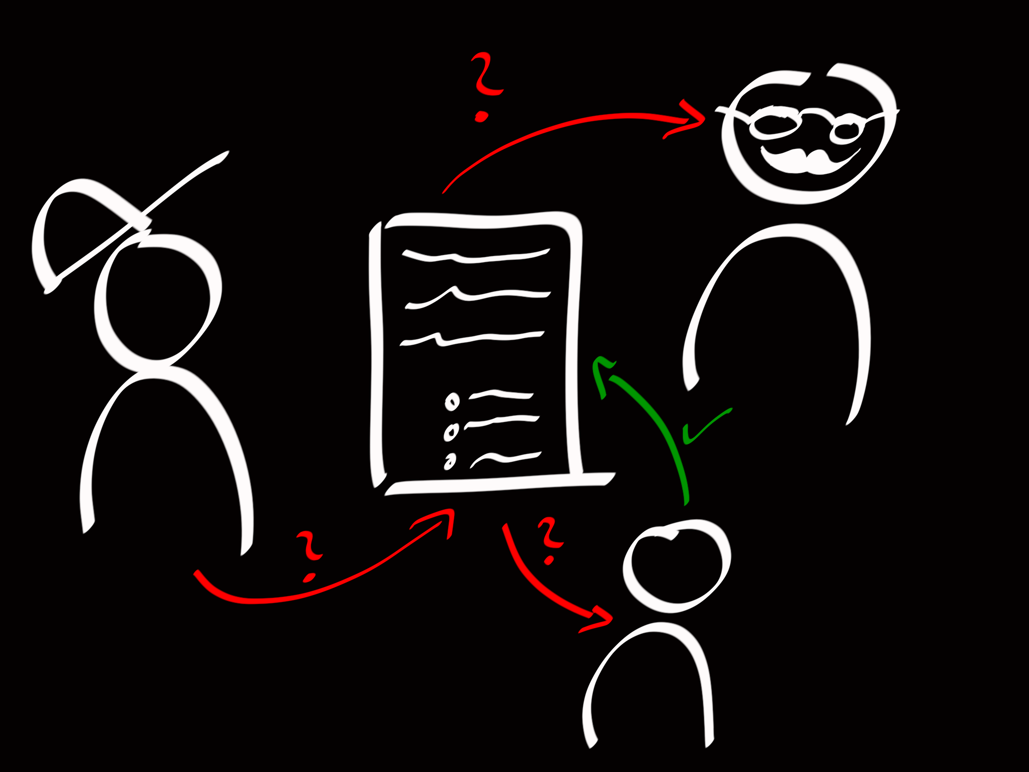

Slide 12
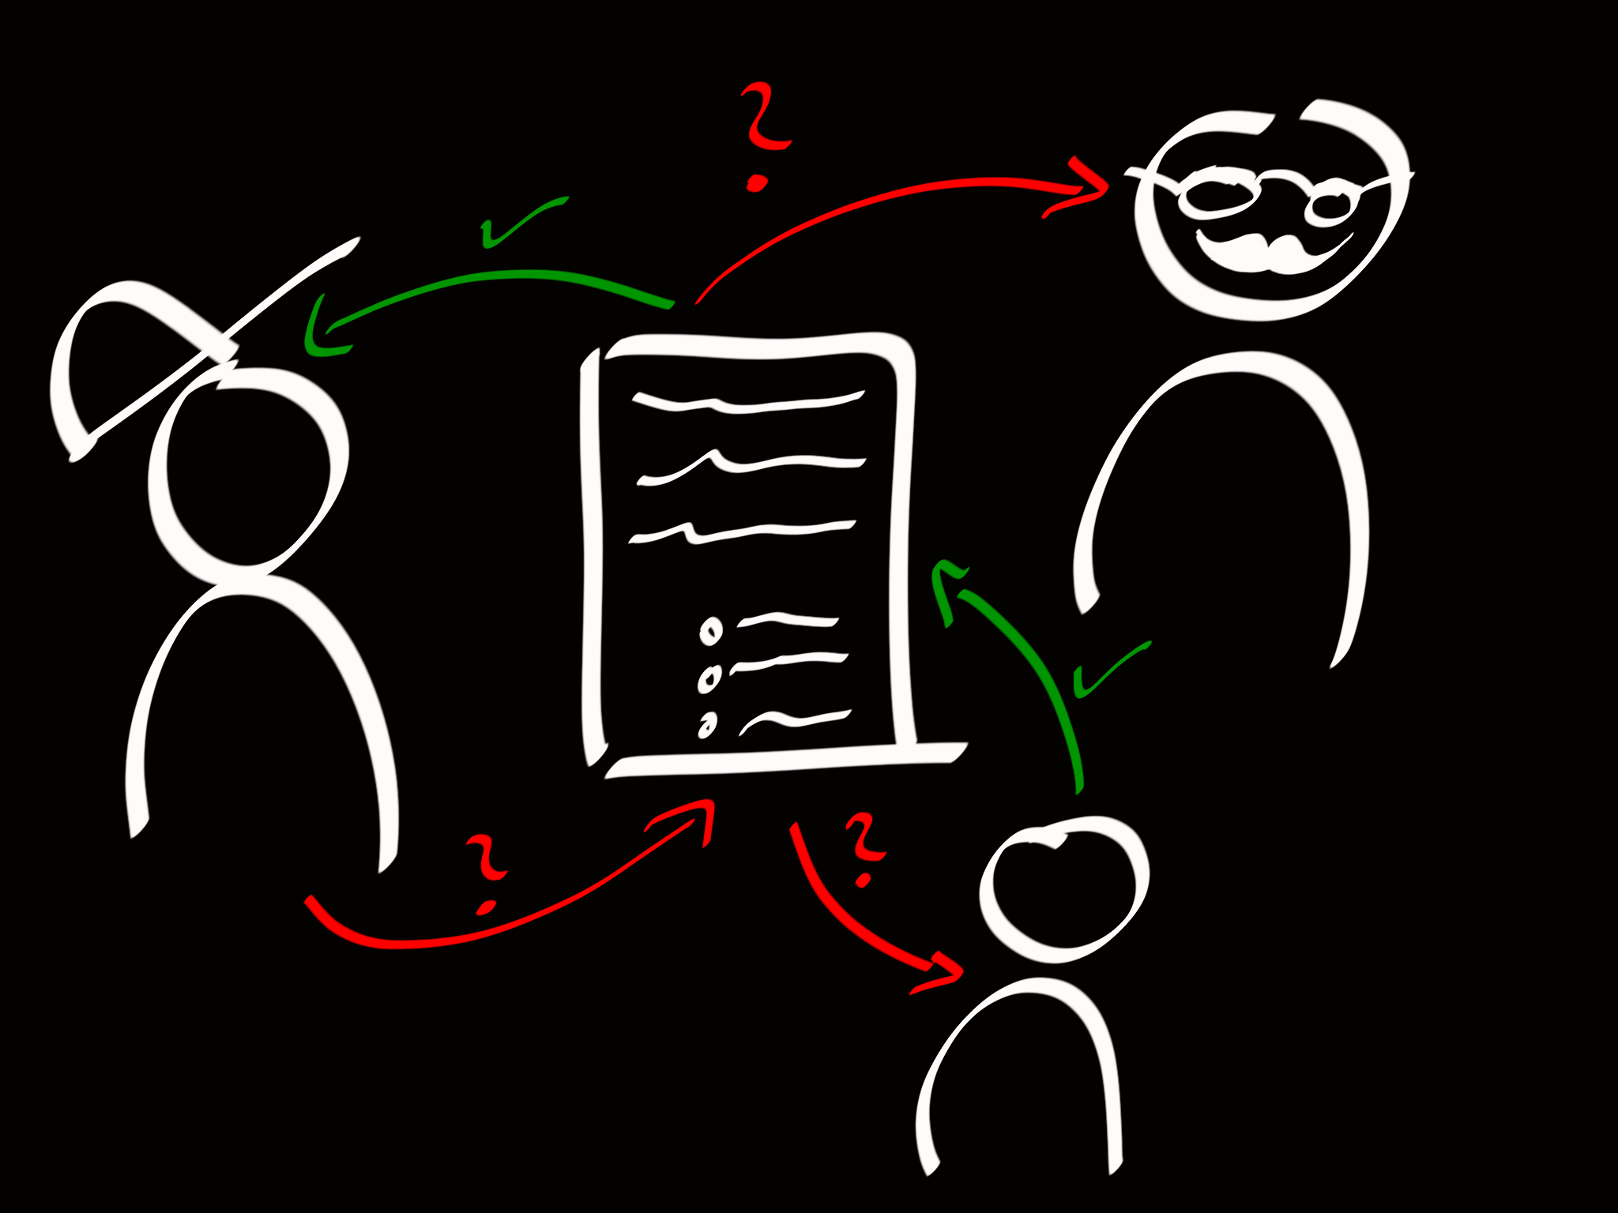

Slide 13

Notes:
Wichtig: glücklich PLUS wissend!!

Slide 14

Notes:
Wichtig: glücklich PLUS wissend!!

Slide 15


Slide 16


Slide 18
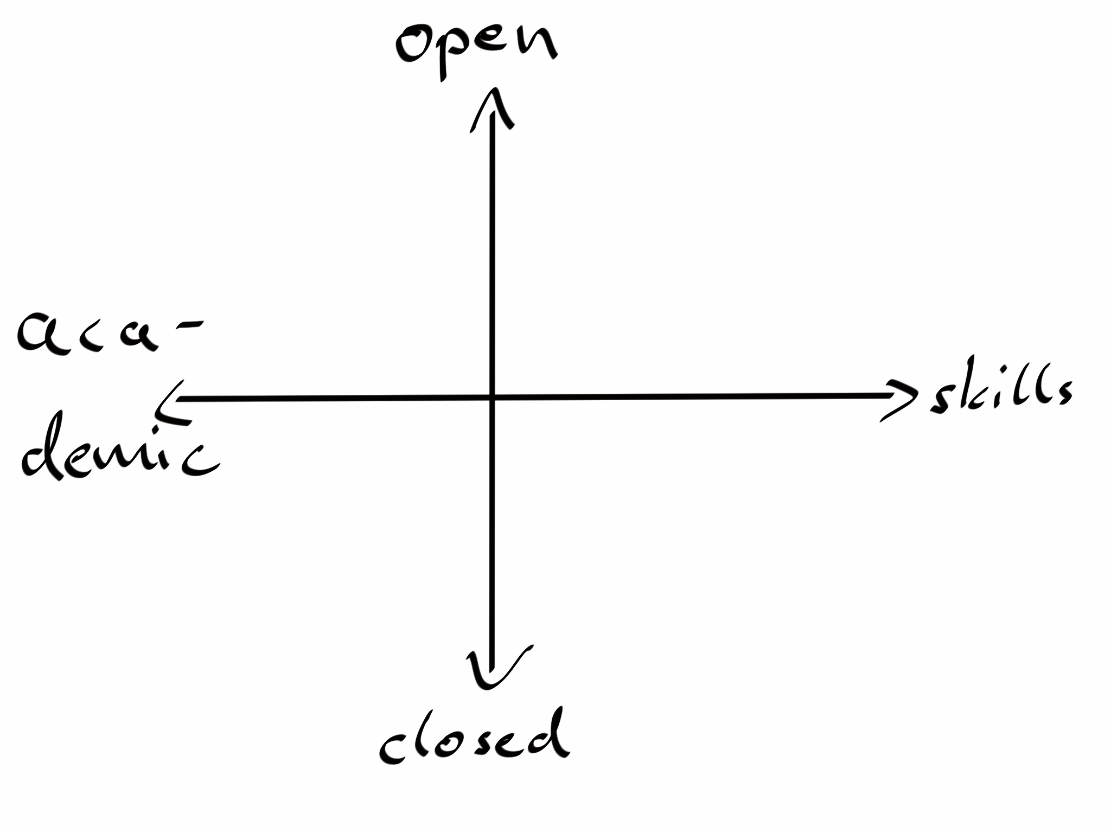








Slide 19




Open
Aca-
demic
Skills
Closed

Slide 20
Supporters (Letter of Intent)
Prof. Dr. Alexander Nicolai, endowed chair of entrepreneurship (University of Oldenburg)
Prof. David Seidl, PhD chair of organization and management (University of Zurich)

Slide 21
Info
http://crowducate.me/ (alpha version)
http://blog.crowducate.me/
info@crowducate.me
http://amir-rahbaran.com/

